Slide 1

FIRWALL: A SUBTOOL INCYBER SECURITY

Slide 2
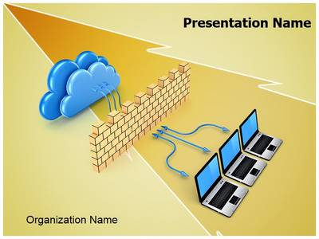
INTRODUCTION :
Cyber Security is a process that's designed to protect networks and devices from external threats .Firewall monitors and controls incoming and out going traffic based on pre define rule .
It Checks incoming and out going packages and controls every activity which is performed by user.

Slide 3
Firewall protects our device from malicious activities . A network firewall is a security device or software that is designed to monitor, filter, and control incoming and outgoing network traffic based on a set of predetermined security rules.
Its primary purpose is to protect a network, whether it's a home network or an enterprise-level network, from unauthorized access, malicious activities, and potential threats from the internet or other networks

Slide 4
Firewall protects our device from malicious activities . A network firewall is a security device or software that is designed to monitor, filter, and control incoming and outgoing network traffic based on a set of predetermined security rules.
Its primary purpose is to protect a network, whether it's a home network or an enterprise-level network, from unauthorized access, malicious activities, and potential threats from the internet or other networks.

Slide 5
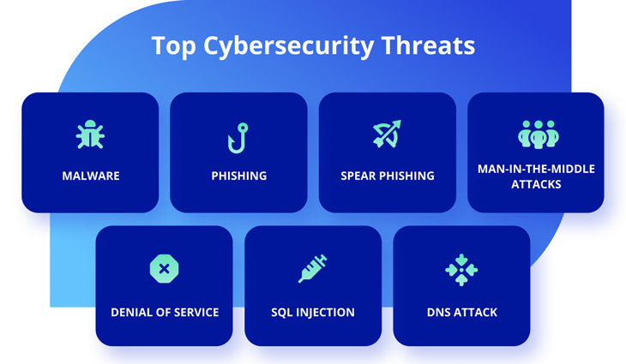
TYPES OF CYBER ATTACK :

Slide 6
TYPES OF FIREWALL :
HOST BASED FIREWALL :
A host-based firewall is a piece of firewall software that runs on an individual computer or device connected to a network.
NETWORK BASED FIREWALL :
A network firewall is hardware or software that restricts and permits the flow of traffic between networks.

Slide 7

VIRTUAL BASED FIREWALL : A virtual firewall is a firewall device or service that provides network traffic filtering and monitoring for virtual machines (VMs) in a virtualized environment.

Slide 8
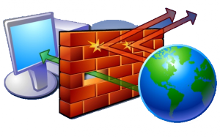
WORKING :
Firewall maintains list of allowed and not allowed computers and the list is called access list .
Firewall notes which
website you are
currently using .
EX – FIREBALL working while watching a video on youtube or other platforms

Slide 9

FEATURES :
PACKET FILERING :
Network firewall is a security device or software that is designed to monitor, filter, and control incoming and outgoing network traffic based on a set of predetermined security rules.

Slide 10
Its primary purpose is to protect a network, whether it's a home network or an enterprise-level network, from unauthorized access, malicious activities, and potential threats from the internet or other networks.
STATEFUL INSPECTION:
Modern network firewalls use stateful inspection to keep track of the state of active connections and make decisions based on the context of the traffic, not just individual packets.

Slide 11
IMPLEMENTATION :
Network Firewall : Protects an entire network by filtering traffic based on rules.
Host-Based Firewall : Installed on individual devices to control traffic at the device level.
Proxy Firewall : Acts as an intermediary between clients and servers, filtering requests and responses.

Slide 12
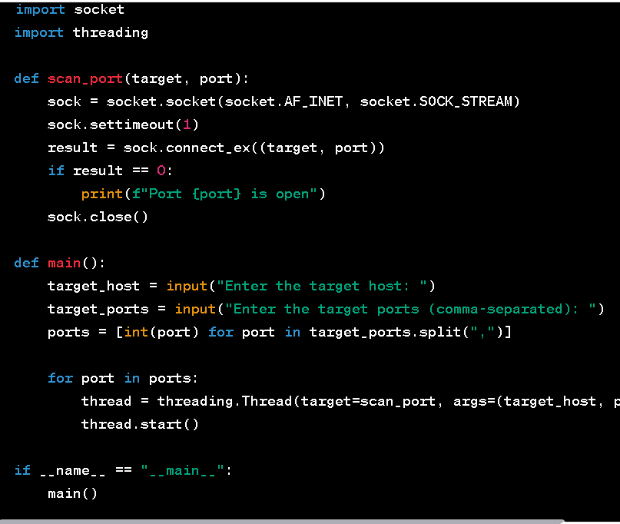
SAMPLE CODE FOR A NETWORK SECURITY TOOL

Slide 13

CONCLUSION :
A firewall is the most important aspect of overall security, since it enforces authentication upon all users, and all inbound and outbound traffic is monitored.
This module has discussed the types of firewalls, as well as the protocols, gateways, and devices used to increase security at the network level.

Slide 14
NAME OF THE STUDENT : ASMITA BAGAL
NAME OF THE STUDENT : TEJAL GAIKWAD
CLASS / DIV : SE CSE (B)
BATCH : B2
ROLL NO : 35 & 37

Slide 15
THANK
YOU

